Slide 1
Data Principles & MS SQL Server
- Lokesh Shukla

Slide 2
Agenda
1
Introduction to DBMS
2
Introduction to RDBMS
3
Entity-Relationship Model
4
Normalization

Slide 3
Objectives
By the end of this module we should be able to:
Comprehend the need for Database
Define File Management System
Comprehend limitations of File Management System
Define Database management system
List the features of DBMS
Database Architecture
Data Models

Slide 4
Need for Databases
Today we live in era where we need data for all our daily to day activities of life.
For instance, a person withdraws money from his/her bank account on his way to office.
During some other part of the day the same person might search some details about some products in the internet .
At another instance we see him/her purchasing grocery items from a nearby supermarket.
In this case, the person does nothing but interact with different databases for different needs.
A Database is set of related data
Notes:
The basic type of database used earlier was the traditional database which has data in the form of text and numbers. But with the advancement in the Computer and Communication Technology we have new types of databases. Though we have different databases for various applications, it is important to get to the basics of the database concepts.

Slide 5
File Management System
Earlier the data was stored as part of File Systems which is a set of computer programs that accomplishes services for end users
It is one of the initial method used to maintain data storage and retrieval on computers
FMS is used to access one file or a single set of related data at one point in time
It is very simple to use and less expensive
Notes:
Earlier organizations were storing data as part of File Systems which is a collection of application programs that perform services for the end users (e.g. reports).In such cases each program defines and manages its own data.

Slide 6
File Management System (Contd.).
Figure to visualize as to how the data is stored in FMS for a bank
Registration Data
Loan Data
Overdue Letters
Registration Program
Loan Program
Overdue Program
Registration File
loan File
customer File

Slide 7
Limitations of File Management System
Separation and isolation of data
Each program maintains its own set of data. so users of one program may be unaware of potentially useful data held by other programs.
Duplication of data
Same data is held by different programs. Space is wasted. Same item can have potentially different values and/or different formats
Data dependence
File structure is defined in the program code.
Incompatible file formats
Programs are written in different languages, and so cannot easily access each other’s files.
Fixed Queries/Proliferation of application programs
Programs are written to satisfy particular functions. Any new requirement needs a new program.

Slide 8
Database Approach
Database Approach emerged mainly because:
The definition of data was embedded in application programs,
rather than being stored separately and independently.
There is no control over access and manipulation of data
beyond that imposed by application programs.
Thus:
Data: is nothing but known facts which is recorded with implicit meaning
Database : it is a collection of logically related data at one place.
Notes:
Modern day Computer-based Information Systems (IS) are capable of serving a variety of complex tasks in a coordinated manner. Such systems handle large volumes of data, multiple users and several applications for activities occurring in a central and/ or distributed environment.
The heart of an IS is Database Management. This is because most IS have to handle massive amounts of data. This core module of an IS is called as Database Management System (DBMS). A DBMS provides for storage, retrieval and updation of data in an organized manner.
An Example: Consider the situation in a library. Here, we have data corresponding to books, authors, suppliers, borrowers, etc. The total volume of data stored and handled in a library may be quite large. The Library DBMS may require several operations such as issue, return or purchase of books; handle queries relating to book information, borrowing information, etc. Moreover, there are different types of users who operate various stages or activities. For example, a borrower may merely view certain information, whereas an issuer may be allowed to update the status of a book during issue or return. The Library staff may on the other hand add new books, their supplier, price and other information to the database. Each user category has a different access right on both the data as well as the processing capabilities. Multiple users may concurrently operate the Library DBMS performing several tasks at the same time. They may even try to access the same data simultaneously. It is the job of a DBMS to handle the data and its processing in an integrated, coordinated and consistent manner. Finally, the Library DBMS must have mechanisms to handle system failure (e.g., failure of power, disk crash, etc.) so that the database can be recovered to a consistent state.

Slide 9
Database Management Systems
A Database Management System (DBMS) is a software system that enables users to define, create, maintain, and control access to the database -
where defining a database means identify the data in terms of data types, structures
constructing the database means to load it on a secondary storage medium
manipulating the database means querying, generating reports, insertions, deletions and modifications to its content.
Controlling is about, managed and authenticated access to data stored.
Notes:
A database management system (DBMS) is a collection of programs that facilitates the process of defining, constructing and manipulating databases.
Defining a database involves specifying the types of data to be stored in the database.
Constructing the database is the process of storing the data.
Manipulating a database includes querying the database, updating the database and generating reports from the data.
A DBMS does the following:
Adding new, empty files to the database
Inserting new data into existing files
Retrieving data from existing files
Updating data in existing files
Deleting data from existing files
Removing existing files, empty or otherwise, from the database

Slide 10
Features of Database Systems
Self-describing nature of a database system:
A DBMS stores the description of the database. The description is called meta-data. This allows the DBMS software to work with different databases.
Insulation between programs and data:
Usually referred as program-data independence. Irrespective of your front-end application type, the approach used for accessing the data will be same.
Data Abstraction:
A data model is used to hide storage details and present the users with a conceptual view of the database

Slide 11
Features of Database Systems (Contd.).
Support of multiple views of the data:
Each user may see a different view of the database, which describes only the data of interest to that user.
Sharing of data and multiuser transaction processing :
allowing a set of concurrent users to retrieve and to update the database.
Notes:
There other main features of a database system are centralized data management, data independence, and systems integration.

Slide 12
Database system
users
Application software / queries
processing queries
Software to access storage data
metadata
databasee
Notes:
A database management system is a complex piece of software that usually consists of a number of modules. The DBMS may be considered as an agent that allows communication between the various types of users with the physical database and the operating system without the users being aware of every detail of how it is done. To enable the DBMS to fulfill its tasks, the database management system must maintain information about the data itself that is stored in the system. This information would normally include what data is stored, how it is stored, who has access to what parts of it and so on. The information (data) about the data in a database is called the metadata. In addition to information listed above, some information regarding the use of a database is often collected to monitor the system's performance. This metadata helps management in maintaining an effective and efficient database system.
Three broad classes of users:
Application programmers: Responsible for writing application programs that use the database
End users: Interact with the system from workstations or terminals. A given end user can access the database via one of the applications, or can use an interface provided as an integral part of the database system software (such interfaces are also supported by means of applications, of course, but those applications are built-in, not user-written, e.g., query language processor)
Database Administrator (DBA): Creates the actual database and implements technical controls needed to enforce various policy decisions. The DBA is also responsible for ensuring that the system operates with adequate performance and for providing a variety of other related technical services.

Slide 13
Database System (Contd.).
user query Q1
Database schema
Application program query Q2
Query processor
DDL compiler
Compiled query
Q2
Database description
Database manager
File manager
Physical database
Notes:
DBMS provides facilities for:
describing the database, when a database is being set up
authorization specification and checking
access path selection
concurrency control
logging and recovery
To provide all the above facilities, a DBMS often has a system architecture as shown in the figure. The main components of the DBMS are:
A Query Language and a Data Description Language (DDL) to provide users the access to the database.
Query processor - translates statements in a query language (or DML) into low-level instructions that the DB manager understands.
Database manager - provides interface between the low level data stored in the database and the application programs and queries submitted to the system.
File manager - manages the allocation of space on disk storage and the data structures used to represent information stored on the disk:
The physical database
The metadata
The above listing of DBMS components is not exhaustive, and also includes some very important components like concurrency controller and recovery manager. These components have not been shown (to keep the architecture relatively simple).

Slide 14
Database Architecture
The major purpose of a database system is to provide users with a view of the system they need and understand.
The system hides certain details of how data is stored, created and maintained.
Complexity should also be hidden from database users. This is achieved through layering. The three levels are:
External Level
Conceptual Level
Internal Level
Notes:
Database change over time as information is inserted and deleted. The collection of information stored in the database at a particular moment is called an instance of the database. The overall design of the database is called the database schema. A DBMS provides a mapping and conversion between these schemas speedily and correctly.

Slide 15
Database Architecture (Contd.).
External
Level /View
View 1
View 2
View 3
Conceptual
Level /View
Physical or internal
Level / View
Notes:
The external level gives the user’s view of the database. This level describes that part of the database that is relevant to each user. The external level consists of a number of different external views of the database. Each user has a view of the ‘real world’ represented in a form that is familiar for that user. The external view includes only those entities, attributes and relationships in the ‘real world’ that the user is interested.
The conceptual level gives the community view of the database. This level describes what data is stored in the database and the relationships among the data. This level contains the logical structure of the entire database. It represents all entities, their attributes and their relationships, the constraints on the data, security and integrity information.
The internal level gives the physical representation of the database on the computer. This level describes how the data is stored in the database. It covers the data structures and file organizations used to store data on storage devices.

Slide 16
Database Architecture (Contd.).
In charge
Inventory staff
External
Level
View 1
Item_Name
Price
View 2
Item_Name
Stock
Conceptual
Item_Number Character (6)
Item_Name Character(30)
Price Numeric(5,2)
Stock Numeric(4)
Conceptual
Level
Physical
Stored_Item Length=50
Item # Type = Byte(6), offset = 0, Index = Ix
Name Type = Byte(30), offset = 6
Price Type = Byte(8), offset = 36
Stock Type = Byte(4), offset = 44
Physical
Level
Notes:
Three important characteristics of the database approach are:
(a) Insulation of programs and data (program-data and program-operation independence).
(b) Support of multiple user views.
(c) Use of a catalog to store database description.
The three schema architecture was proposed to achieve these characteristic.
The Three levels of architecture:
The goal of the three schema architecture is to separate the user applications and the physical database.
The internal level is the one closest to the physical storage, i.e., it is the one concerned with the way data is physically stored
The external level is the one closest to the user, i.e., it is the one concerned with the way data is viewed by individual users
The conceptual level is a level of indirection between the other two
There will be many distinct external views, each consisting of a more or less abstract representation of some portion of the total database, and there will be one conceptual view, consisting of a similarly abstract representation of the database in its entirety. Likewise there will be precisely one internal view, representing the total Database as physically stored.

Slide 17
Data Independence
A major objective for the three-level architecture is to provide data independence, which means that upper levels are unaffected by changes to lower levels.
There are two kinds of data independence: logical and physical.
Logical data independence is the ability to make change in the conceptual schema without causing a modify in the user views or application program.
Physical data independence is the ability to make change in the internal schema without causing a modify in the conceptual schema or application program
The description of the database which is designed in the early stage and is not expected to change frequently is called the database schema

Slide 18
Data Models
There are three structural Models of database management systems:
Hierarchical Model
Network Model
Relational Model

Slide 19
Hierarchical Data Model
Hierarchical Model:
It represents data as hierarchical tree.
It is a very efficient model in case of searching.
But it has some issues when a data element is associated with more than one group.
HIERARCHICAL
Notes:
Hierarchical model is the oldest of the database models, and unlike the other data models, does not have a well documented history of its conception and initial release. It is derived from the Information Management Systems (IMS) of IBM in the 1950's and 60's

Slide 20
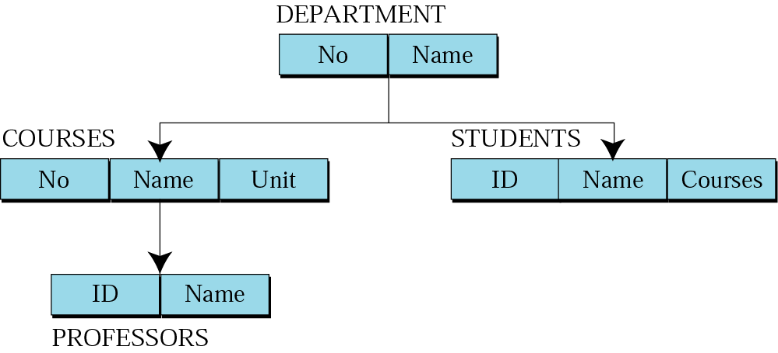
Hierarchical Data Model (Contd.).

Slide 21
Network Data Model
Network Model:
This is a solution for Hierarchical Model issue.
It reperesents data as record types.
Each record has a link field to every relationship which it participates in circular linked list
But it has very less structural data independence and high system complexity.
NETWORK
Notes:
The Network database model was first introduced in 1971 by CODASYL Data Base Task Group It is called the Network Model because it represents the data it contains in the form of a network of records and sets which are related to each other, forming a network of link

Slide 22
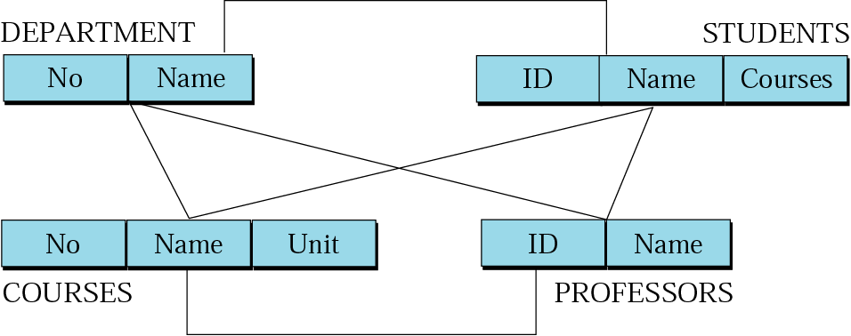
Network Data Model (Contd.).
Notes:
The network model is not commonly used today to design database systems, however, there are a few instances of it being used by companies as part of a legacy system. Because it represents data in a format closer to the way in which it stores it than the other models, it can be faster than relational systems. Unfortunately, this increase in speed is at the cost of its adaptability.

Slide 23
Network Model (Contd.).
Advantages:
Simplicity
Integrity
Ability to handle more relationship types
Ease of data access
Integrity
Data Independence
Disadvantages:
System Complexity
Lack of Structural independence
Notes:
ADVANTAGES: Provide very efficient "High-speed" retrieval
Simplicity:
The network model is conceptually simple and easy to design.
Ability to handle more relationship types:
The network model can handle the one-to-many and many-to-many relationships.
Ease of data access:
In the network database terminology, a relationship is a set. Each set comprises of two types of records.- an owner record and a member record, In a network model an application can access an owner record and all the member records within a set.Data Integrity
In a network model, no member can exist without an owner. A user must therefore first define the owner record and then the member record. This ensures the integrity.
Data Independence:
The network model draws a clear line of demarcation between programs and the complex physical storage details. The application programs work independently of the data. Any changes made in the data characteristics do not affect the application program.

Slide 24
Notes:
DISADVANTAGES
System complexity:
In a network model, data are accessed one record at a time. This males it essential for the database designers, administrators, and programmers to be familiar with the internal data structures to gain access to the data. Therefore, a user friendly database management system cannot be created using the network model
Lack of Structural independence.
Making structural modifications to the database is very difficult in the network database model as the data access method is navigational. Any changes made to the database structure require the application programs to be modified before they can access data. Though the network model achieves data independence, it still fails to achieve structural independence.

Slide 25
Relational Data Model
Relational Model:
Network model is replaced with relational model.
It represents data as record types in table format.
Relationship between records are maintained using logical data.
RELATIONAL
COLUMN
ROW
VALUE
TABLE
Notes:
The Relational Model is the data model which is based on the relational algebra of mathematics. It was first outlined in a paper published by E F . Codd in 1970. It is used by the majority of business community today.

Slide 26
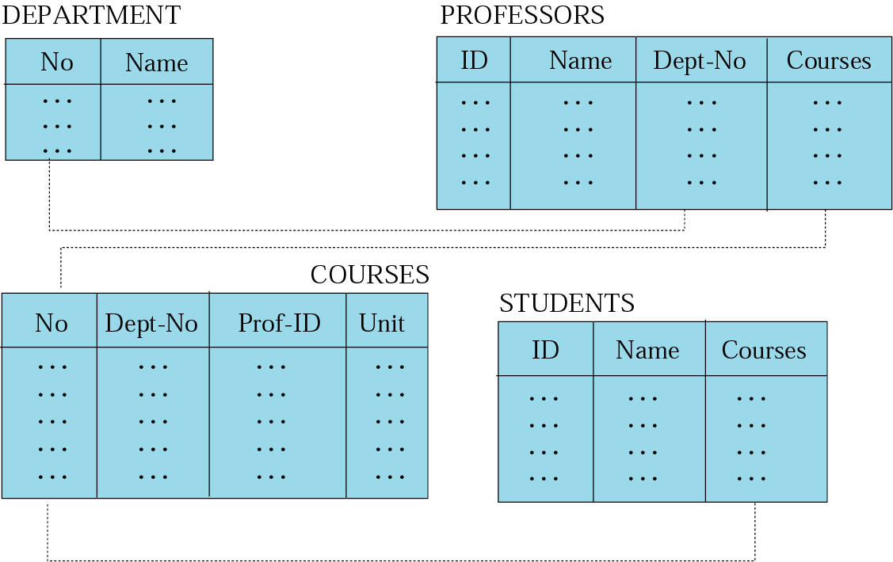
Relational Data Model (Contd.).

Slide 27
Summary
In this module we learnt to:
Comprehend the need for Database
Define File Management System
Comprehend limitations of File Management System
Define Database management system
List the features of DBMS
Database Architecture
Data Models

Slide 28
Objectives
By the end of this module we will learn
Definition: RDBMS
Codd's Rules
Some Important Terms
Keys

Slide 29
Definition of RDBMS
Edgar F. Codd at IBM invented the relational database in 1970, which is usually referred to as RDBMS
RDBMS allows operations in a human logical environment.
The main elements of RDBMS are based on Codd’s 13 rules for a relational system.
The relational database is perceived as a collection of tables.
Each table consists of a series of row/column intersections.
Tables (or relations) are related to each other by sharing a common entity characteristic.

Slide 30
Rules of Dr. E F Codd
Rule 0.
For a system to qualify as a RELATIONAL, DATABASE, MANAGEMENT system, that system must use its RELATIONAL facilities (exclusively) to MANAGE the DATABASE.
Rule 1: Information rule
The information rule simply requires all information in the database to be represented in one and only one way, Namely by values in column positions within rows of tables.
Rule 2: Guaranteed access rule
The data can be accessed by specifying the table name and the column name and the columns that defined the primary key . Primary key ensures that each value is unique and accessible.

Slide 31
Rules of Dr. E F Codd (Contd.).
Rule 3: Systematic treatment of NULL values
A null is a unknown value and every database must have a provision for storing NULL values.
NULL != 0
NULL != nothing
NULL != NULL
NULL is NULL
Rule 4: Dynamic on-line catalog based on the relational model
In this rule it says; to have user data in tables(in user tables) and the information about the table such as structure and other required information also in tables( in System Catalog) only.
User data in user-tables and metadata of/about user-table as system catalog.
Rule 5: Comprehensive sub language
There must be at least one language which supports data defining, view defining , manipulating data, integrity constraints.
All the above should be supported with well defined syntax, as character strings.

Slide 32
Rules of Dr. E F Codd (Contd.).
Rule 6: View updating rule
Should support a mechanism which designs different combinations of data from different tables called as views. All the view should be updateable.
Views are virtual tables that contains extraction of data from the source tables
Either it is a simple view or a complex view it should allow updates to the view.
Rule 7: High level insert update and delete rule
Data manipulation operations treat Rows as a set. These set operations and relational operators are used to work on table.
Use of insert, update and delete operations on views should act on their respective tables

Slide 33
Rules of Dr. E F Codd (Contd.).
Rule 8: Physical data independence rule
Changes in the data storage should not effect programs that access the data.
Rule 9: Logical data independency rule
The data is stored in the files physically, but tables are logical structures. So for making any changes need in logical structures there is no need of any change in the application.
Rule 10: Integrity independency rule
Data integrity means the consistency and accuracy which keeps the garbage out of the database.
Integrity constraints must be the supported functionality of any database application.

Slide 34
Rules of Dr. E F Codd (Contd.).
Rule 11: Distribution rule
To the end user all the commands should be working a same as it would working for the local database even though the database is in some other place and user is accessing through network.
Rule 12: Non subversion rule
All the constraints defined by the user using the SQL should not be bypased by any other way.

Slide 35
Some Important Terms
Relation : a table
Tuple : a row in a table
Attribute : a Column in a table
Degree : number of attributes
Cardinality : number of tuples
Primary Key : a unique identifier for the table
Domain : a pool of values from which specific attributes of specific relations draw their values
Notes:
Domain :
An attribute of an entity set has a particular value. The set of possible values that a given attribute can have is called its domain.
For example, the set of values that the attribute EMPLOYEE.id can assume is a positive integer of 5 digits.
Primary Key :
A unique identifier for the table (a column or a column combination with the property that at any given time no two rows of the table contain the same value in that column or column combination).

Slide 36
Keys
Key
An attribute or a set of attributes whose values uniquely identify each entity in an entity set
Super Key
A key whose values uniquely identify each entity in an entity set, which is generally all combination subsets of the table.
Candidate Keys – smallest subsets are identified as candidate keys
Primary Key: Chosen key to uniquely identify a table
Alternate Key: other candidate keys are termed as alternate keys
Secondary Keys
Keys that classify the entity set
Notes:
Key: An attribute or set of attributes whose values uniquely identify each entity in an entity set is called a key for that entity set.
Super Key: If we add additional attributes to a key, the resulting combination would still uniquely identify an instance of the entity set. Such augmented keys are called super keys.
Primary key: It is a minimum super key.
Candidate Keys : There may be two or more attributes or combinations of attributes that uniquely identify an instance of an entity set. These attributes or combinations of attributes are called candidate keys.
In such a case we must decide which of the candidate keys will be used as the primary key. The remaining candidate keys would be considered alternate keys.
Secondary Key: A secondary key is an attribute or combination of attributes that may not be a candidate key but that classifies the entity set on a particular characteristic.
A case in point is the entity set EMPLOYEE having the attribute department, which identifies by its value all instances EMPLOYEE who belong to a given department.
Any key consisting of a single attribute is called a simple key while that consisting of a combination of attributes is called a composite key.

Slide 37
Keys and Referential Integrity
Enrolled
Student
sid
cid
grade
sid
name
login
age
gpa
53666
carnatic101
C
53666
Jones
Jones@cs
18
3.4
53688
reggae203
B
53688
Smith
Smith@eecs
18
3.2
53650
topology112
A
53650
Smith
Smith@math
19
3.8
53666
history105
B
Primary key
Foreign key referring to
sid of STUDENT relation
The primary key of a relational table uniquely identifies each record in the table. It can either be a normal attribute that is guaranteed to be unique
A foreign key is a field in a relational table that matches the primary key column of another table.
Notes:
A set of fields is a key for a relation if :
1. No two distinct tuples can have same values in all key fields, and
2. This is not true for any subset of the key.
If there’s >1 key for a relation, one of the keys is chosen (by DBA) to be the primary key . Eg. sid is a key for Students. (What about name ?) The set {sid, gpa} is a superkey.
Possibly many candidate keys (specified using UNIQUE), one of which is chosen as the primary key .
Foreign key: Set of fields in one relation that is used to `refer’ to a tuple in another relation. (Must correspond to primary key of the second relation.) Like a `logical pointer’.
Eg. sid is a foreign key referring to Students:
– Enrolled (sid: string, cid: string, grade: string)– If all foreign key constraints are enforced, referential integrity is achieved, ie., no dangling references.
Enforcing Referential Integrity
Consider Students and Enrolled; sid in Enrolled is a foreign key that references Students. What should be done if an Enrolled tuple with a non-existent student id is inserted? (Reject it!)
What should be done if a Students tuple is deleted?
– Also delete all Enrolled tuples that refer to it.
– Disallow deletion of a Students tuple that is referred to.
– Set sid in Enrolled tuples that refer to it to a default sid
– (In SQL, also: Set sid in Enrolled tuples that refer to it to a special value null, denoting `unknown’ or `inapplicable’) Similar if primary key of Students tuple is updated.

Slide 38
Relations or Tables properties
There are no duplicate rows (tuples)
Tuples are unordered, top to bottom
Attributes are unordered, left to right
All attribute values are atomic ( or scalar )
Relational databases do not allow repeating groups

Slide 39
Summary
In this module we learnt :
Definition of RDBMS
Codd's Rules
Some Important Terms
Keys

Slide 40
Objectives
By the end of this module we should be able to:
Designing the database
Modeling Entity Relationship diagram
How to draw an entity relationship diagram

Slide 41
Database Design: Overview
Conceptual design : (using ER Model)
Normalization
Physically designing Database
Notes:
The database design can be divided into following steps:
Requirement Analysis: First of all, we should be clear about what the users want from database, what data to be stored, and operations to be performed.
Conceptual Design: The information gathered in the requirements analysis step is used to develop a high level description of the data to be stored in the database. In this step we have to address the following:
What are the entities and relationships in the enterprise?
What information about these entities and relationships should we store in the database?
What are the integrity constraints or business rules that hold?
This step is often carried out using the ER model, or a similar high-level model. A database `schema’ in the ER Model can be represented pictorially (ER diagrams ).
Logical Database Design: We must choose a DBMS to implement our database design, and convert the conceptual database design into a database schema in the data model of the chosen DBMS. For example, we can map an ER diagram into a relational database schema.
Normalization: Check relational schema for redundancies and related anomalies.
Physical Database Design: Consider typical workloads and further refine the database design.

Slide 42
E- R Modeling
Conceptual Schema Design
Relational Calculus
Formal Language for Relational D/B.
Relational Calculus
Predicate Calculus
Domain Calculus
SQL / Tuple Based
Query By Examples
Notes:
E R Modeling: A Design based on Conceptual Schema Design is Entity Relation Based Design / Modeling.
Relational Calculus is broadly classified into:
Predicate Calculus: Based on Tuple based or Row based Design. Many of the concepts of SQL come under the category.
Domain Related Calculus :Retrieval based on Values given by attributes and expressions. RQBE ( Relational Query By Examples) is an example of the category.

Slide 43
E-R Modelling Design Phases
Requirement Collection & Analysis
Data Requirements
Functional Requirements
Conceptual Design
User Defined Operations
Data Flow Diagrams,
Sequence Diagrams,
Scenarios
Entity Types, Constraints, Relationships No Implementation Details.
Ensures Requirements Meets the Design
Logical Design
Data Model Mapping – Type of Database is identified
Physical Design
Internal Storage Structures / Access Path / File Organizations
Notes:
The Basic Design Phases is divided into different phases:
Requirement Collection & Analysis: The Database Designers Interview Prospective Database users to understand and Document their Data requirements. The result of this step is concisely written set of users requirements. This concept of user defined operations that will be applied to the database and they include both retrievals and updates in soft ware design.
2. Conceptual Design: It is a concise description of the data requirements of the users and include detailed descriptions of the entity types , relationships and constraints and they are expressed using the concepts provided by the high level data model.
3. Logical Design: Identification of Data Model Mapping is done here. RDBMS / DBMS / Object Model
4. Physical Design: The Internal storage structures / access paths and file organizations for the database files are specified. These Activities and application programs are designed and implemented as database transactions corresponding to the high level specifications.

Slide 44
E-R Modeling: Terminology
Entity
is anything that exists and is distinguishable
Entity Set
a group of similar entities
Attribute
properties that describe an entity
Relationship
an association between entities
Notes:
Entity:
An Entity is a thing that exists and is distinguishable.
For example, each chair is an entity. So is each person and each automobile.
Entities can have concrete existence or constitute ideas or concepts.
Concepts like love and hate are entities.
Entity Set:
A group of similar entities forms an entity set.
Examples of entity sets are:
1. All Persons
2. All Automobiles
3. All Emotions
Attributes:
Attributes are the properties that characterize an entity set.
For example, employees of an organization are modeled by the entity set EMPLOYEE. We must include in the model the properties of the employees that may be useful to the organization. Some of these properties are name, address, skill etc.
Relationship: It is an association between two or more entities. For example, we may have the relationship that an employee works in a department.

Slide 45
ER Modeling Notations
ENTITY TYPE
WEAK ENTITY TYPE
ATTRIBUTE TYPE
WEAK RELATIONSHIP TYPE
RELATIONSHIP TYPE
Notes:
These are the basic type of notations that we use generally while drawing ER diagrams
There are two types of entities one is regular and another is weak
A weak entity is that which depends only on some other entity for its existence

Slide 46
ER Modeling: Entity
Ename
Emp No
Salary
Employee Table
Employee
Emp No | Ename | Salary
Entity set
Notes:
Entity: Entity is a real world object distinguishable from other objects. It could be an object, place, person, concept or activity about which an enterprise records data. To qualify some thing as entity its should have:
Have independent existence
Be of interest to us.
Also,
Entity is a set of attributes
Entity is a collection of similar entities. Example: All employees
Entity are all entities in an entity set that have a same set of attributes
Each entity set has a key
Each attribute has a domain
Entity can be mapped to a relation easily

Slide 47
ER Modeling: Types of Relationships
1
Is issued
1
Student
ID Card
1
Enroll for
M
Student
course
M
takes
M
Student
Take
Notes:
A relationship is defined as an association among entities.
There are 4 types of relationships
One to one
One to many
Many to one
Many to many

Slide 48
E-R Modeling :E-R Model
Name
Dname
Empno
Salary
Loc
Deptno
Works in
Employee
Dept
Manager
Sub-ordinate
Reports-To
Since
Notes:
The above diagram shows one employee reports to another employee.
When ever we have such kind of relation in a ER diagram we cannot put two entities of a same type.
A relationship can also have a attribute
Which indicates that the relationship is unique by the combination of empno and deptno

Slide 49
ER-Modeling: Key Constraint
Name
Dname
Empno
Salary
Loc
Deptno
Works in
Employee
Dept
Sub-ordinate
Reports-To
Since
Notes:
A key constraint between an entity set S and a relationship set restricts instances of the relationship set by requiring that each entity of S participate in at most one relationship.
Consider Manages: Each dept has at most one manager, according to the key constraint on ‘Manages’ relationship (In contrast, Works_In relationship of earlier slide shows that an employee can work in many departments and a dept can have many employees). The arrow from Department to Manages indicates that each Department entity appears in at most one Manages relationship in any allowable instance of Manages. Thus given a Department entity, we can uniquely determine the Manages relationship in which it appears.
Translating ER Diagrams with Key Constraints:
Map relationship to a table: Note that did is the key now!
– Separate tables for Employees and Departments.
Since each department has a unique manager, we could instead combine Manages and Departments.
Manages table without Key constraint:
CREATE TABLE Manages(
ssn CHAR( 11), did INTEGER, since DATE, PRIMARY KEY (did), FOREIGN KEY (ssn)
REFERENCES Employees, FOREIGN KEY (did) REFERENCES Departments)

Slide 50
Key Constraints For Ternary Relationships
Name
Since
Dname
Empno
Salary
Loc
Deptno
Works in
Employee
Dept
Sub-ordinate
Reports-To
Location
Address
Address
Notes:
Ternary Relationship: A relationship set involving three entity sets is known as a ternary Relationship.
Eg. Works_in relationship involving Employee, Department and Location Entity sets.
In the above slide, we show a ternary relationship with a key constraint. The key constraint indicates that each employee works in at most one department, and at a single location. Notice that each department can be associated with several employees and locations, and each location can be associated with several departments and employees; however, each employee is associated with a single department, and location.

Slide 51
E-R Modeling Participation Constraints
Name
Dname
Empno
Salary
Loc
Deptno
Manages
Employee
Dept
Reports-To
Notes:
The key constraint on Manages tells us that a Department has at most one Manager (indicated by arrow). Let us now ask: Does every department have a manager? If so, this is a participation constraint: the participation of Departments in Manages is said to be total (vs. partial). The total participation is indicated by a dark line between entity and relationship. A participation that is not total is said to be partial. Eg. participation of Employee in Manages is partial. The participation constraint specifies whether the existence of an entity depends on its being related to another entity via the relationship type.
A participation constraint between an entity set S and a relationship set restricts instances of the relationship set by requiring that each entity of S participate in at least one relationship.
Every did value in Department table must appear in a row of the Manages table (with a non- null ssn value!).
Similarly, every ssn value in Employee table must appear in a row of the Works_in table.
Participation Constraints in SQL: We can capture participation constraints involving one entity set in a binary relationship, but little else (without resorting to CHECK constraints).
CREATE TABLE Dept_ Mgr(
did INTEGER, dname CHAR( 20), budget REAL,
ssn CHAR( 11) NOT NULL, since DATE,
PRIMARY KEY (did), FOREIGN KEY (ssn) REFERENCES Employees,
ON DELETE NO ACTION )

Slide 52
E-R Modeling: Weak entities
Name
Dname
Empno
Salary
Loc
Deptno
Policy
Employee
Dept
Notes:
A weak entity’s existence is dependent on another (owner) entity. Hence a weak entity will not have it’s own key. It can be identified uniquely only by considering the primary key of it’s owner entity.
– Owner entity set and weak entity set must participate in a one-to-many relationship set (1 owner, many weak entities).
– Weak entity set must have total participation in this identifying relationship set.
Translating Weak Entity Sets:
Weak entity set and identifying relationship set are translated into a single table.
– When the owner entity is deleted, all owned weak entities must also be deleted.
Eg. If the employee quits, any policy owned by the employee is terminated. All the relevant policy and dependent information is also deleted from the database.
To indicate that Dependent is a weak entity and policy is its identifying relationship, we draw both with dark lines.
CREATE TABLE Dep_ Policy (
pname CHAR( 20), age INTEGER, cost REAL,
ssn CHAR( 11) NOT NULL,
PRIMARY KEY (pname, ssn),
FOREIGN KEY (ssn) REFERENCES Employees,
ON DELETE CASCADE )

Slide 53
E-R Modeling: IS A (‘is a’) hierarchies
Employee
IS A
Hourly Employee
Contract Employee
Notes:
As in C++, or other Programming Languages, attributes are inherited.
If we declare A ISA B, every A entity is also considered to be a B.
entity. (Query answers should reflect this: unlike C++!)
Overlap constraints : Can Joe be an Hourly_ Emp as well as a Contract_ Emp entity? ( Allowed/ disallowed )
Covering constraints : Does every Employee entity also have to be an Hourly_ Emp or a Contract_ Emp entity? (Yes/ no)
Reasons for using ISA :
– To add descriptive attributes specific to a subclass .
– To identify entities that participate in a relationship
Translating ISA Hierarchies to Relations:
General approach:
– 3 relations: Employee, Hourly_ Emp and Contract_ Emp.
Hourly_ Emp : Every employee is recorded in Employee.
For hourly emps, extra info recorded in
Hourly_ Emp ( hourly_ wages, hours_ worked, ssn) ;
must delete Hourly_ Emps tuple if referenced Employees tuple is deleted).
Queries involving all employees easy, those involving just Hourly_ Emp require a join to get some attributes.
Alternative: Just Hourly_ Emp and Contract_ Emp.
– Hourly_ Emp : ssn, name, lot, hourly_ wages, hours_ worked.
– Contract_ Emp : ssn, name, lot, contractid.
– Each employee must be in one of these two subclasses

Slide 54
E-R Modeling : Entity Vs. Attribute
It is always a question, should address be a attribute of employee entity or an individual entity.
Depends upon the use we want to make of address information, and the semantics of the data:
If we have several addresses per employee, address must be an entity (since attributes cannot be set- valued).
If the structure (city, street, etc.) is important, e.g., we want to retrieve employees in a given city, address must be modeled as an entity (since attribute values are atomic).
Otherwise, address can be used as an attribute of Employee.

Slide 55
E-R Modeling : Entity Vs. Attribute (Contd.).
Name
Empno
Address
City
Employee
Street
State
Address
Notes:
Similar to the problem of wanting to record several addresses for an employee: we want to record several values of the descriptive attributes for each instance of this relationship.
Consider that an employee works in a given department over more than one period. This possibility is ruled out by the ER diagram’s semantics of previous slide. The problem is that we want to record several values for descriptive attributes for each instance of Works_in relationship. We can address this problem by introducing an entity set called Duration, with attributes from and to.

Slide 56
E-R Modeling: Entity Vs. Relationship (Contd.).
Name
Dname
Since
Empno
Budget
Budget
Salary
Deptno
manages
Employee
Dept
Notes:
ER diagram OK if a manager gets a separate discretionary budget for each dept. What if a manager gets a discretionary budget that covers all managed depts?
– Redundancy of dbudget, which is stored for each dept managed by the manager.
– Misleading: suggests dbudget tied to managed dept.

Slide 57
E-R Modeling : Entity Vs. Relationship (Contd.).
Name
Dname
Empno
Budget
Salary
Deptno
Manages
Employee
Dept
Since
Apptnum
Mgr_Appt
DBBudget
Notes:
One of the possible designs to resolve the two issues of the previous ER diagram:
We model the appointment as an entity set, say Mgr_appt, and use a ternary relationship, say manages, to relate a manager, an appointment, and a department. The dbudget is now associated with the appointment of the employee as manager of a group of departments. The details of an appointment (such as the discretionary budget) are not repeated for each department that is included in the appointment now, although there is still one Manages relationship instance per such Department.

Slide 58
E-R Modeling: Binary .vs. ternary Relationships
Name
Age
Empno
Salary
Pname
Covers
Employee
Dependent
Policyid
Policy
Cost
Notes:
Above figure models a situation in which an employee can own several policies, each policy can be owned by several employees, and each dependent can be covered by several policies.
Suppose we have following constraint:
Each policy is owned by just 1 employee.
– Key constraint on Policy would mean policy can only cover 1 dependent!

Slide 59
Binary vs. Ternary Relationships (Contd.).
Name
Better design
Empno
Age
Salary
Pname
Employee
Dependent
Covers
Covers
Policyid
Policy
Cost
Notes:
The key constraints allow us to combine Purchaser with Policy and Beneficiary with Dependent.
Participation constraints lead to NOT NULL constraints.
CREATE TABLE Policy (
policyid INTEGER,
cost REAL,
ssn CHAR( 11) NOT NULL,
PRIMARY KEY (policyid),
FOREIGN KEY (ssn) REFERENCES Employee,
ON DELETE CASCADE )
CREATE TABLE Dependent (
pname CHAR( 20),
age INTEGER,
policyid INTEGER,
PRIMARY KEY (pname, policyid),
FOREIGN KEY (policyid) REFERENCES Policy,
ON DELETE CASCADE )

Slide 60
E-R Modeling: Constraints Beyond the E-R model
Some constraints cannot be captured in ER Diagrams:
Functional dependency
Inclusion dependency
General constraints
Notes:
Constraints in the ER Model:
– A lot of data semantics can (and should) be captured.
– But some constraints cannot be captured in ER diagrams.
Need for further refining the schema:
– Relational schema obtained from ER diagram is a good first step. But ER design subjective & can’t express certain constraints; so this relational schema may need refinement.
Functional dependencies:
– e. g., A dept can’t order two distinct parts from the same supplier .
Can’t express this wrt ternary Contracts relationship.
– Normalization refines ER design by considering FDs.
Inclusion dependencies:
– Special case: Foreign keys (ER model can express these).
– e. g., At least 1 person must report to each manager. (Set of ssn values in Manages must be subset of supervisor_ ssn values in Reports_ To.) Foreign key? Expressible in ER model?
General constraints:
– e. g., Manager’s discretionary budget less than 10% of the combined budget of all departments he or she manages.

Slide 61
E-R modeling: Converting to Tables
E-R Diagram shows the concept and tables represent the concept of data showcased by the E-R Diagram
Moving an E-R Diagram to a table consists of the following steps:
Identifying the Primary Key to every entity
Forming Foreign Keys where ever entity relationship is established
Based on the type of relationship we need (1:1 or 1:M or N:M) constraints has to be placed or a new table has to be created to represent the relationship

Slide 62
E-R modeling: Converting to Tables (Contd.).
EMPLOYEE
DEPARTMENT
EName
Salary
Department Name
Location
EMPNO | Ename | Salary | DeptNo
12 | ABC | 2000 | 10
13 | DEF | 2400 | 10
Deptno | DepartmentName | Location
10 | Accounts | Chennai
20 | FMG | Bangalore
Notes:
You could see, Empno and Deptno has been added to represent uniqueness to the tables.
Relationship is referenced with Deptno fom department table is added to employees table.

Slide 63
Conceptual Design in short
Conceptual design follows requirements analysis
Yields a high – level description of data to be stored
ER model popular for conceptual design
Constructs are expressive, close to the way people think about their applications.
Basic contracts: entities, relationships, and attributes (of entities and relationships)
Some additional constructs: weak entities, ISA hierarchies, and aggregations
Note: there are many variations on ER model.

Slide 64
Limitations of E-R diagrams
Even though different kinds of veracity constraints can be shown in the ER model but some cannot be.
For example check constraint cannot be shown
We may not be able to show functional dependencies

Slide 65
Summary
In this module we learnt
Designing the database
Modeling Entity Relationship diagram
How to draw an entity relationship diagram

Slide 66
Objectives
At the end of this module we will learn:
What is normalization
Goals Of Normalization
Problems with un-normalized data
Normal forms

Slide 67
Normalizations and Normal Forms
What is Normalization:
Normalization is the process of organizing data in a database.
This includes creating tables and establishing relationships between those tables according to rules designed both to protect the data and to make the database more flexible by eliminating two factors: redundancy and inconsistent dependency
Types of Normal forms:
First normal form(1NF)
2nd normal form(2NF)
3rd normal form(3NF)
Notes:
Normalization is a step by step process which will break the data in to small tables and where the insert, update and delete anomalies will be avoided.
There are different steps of normalizations
Such as
First normal form
2nd normal form
3rd normal form

Slide 68
Normal Forms
There are a few rules for database normalization. Each rule is called a "normal form."
If the first rule is observed, the database is said to be in "first normal form."
If the first three rules are observed, the database is considered to be in "third normal form."
Although other levels of normalization are possible, third normal form is considered the highest level necessary for most applications.

Slide 69
Goals Of Normalization
Eliminate Redundancies Caused By:
Fields Repeated Within A File
Fields Not Directly Describing The Key Entity
Fields Derived From Other Fields
Avoid Anomalies In Updating (Adding, Editing,
Deleting)
Represent Accurately The Items Being Modeled
Simplify Maintenance And Retrieval Of Info
Notes:
We need to ask whether our data base needs any further refinement. If needed then we need to know at present in which form we are so that we can understand what the next task we need to do for further refinement.
All the problems related the database are categorized and solved in different normal forms which acts like filters in each level.
We understand the state of the database only after finding in which normal form the database is.
Being a database designer it is our responsibility to make sure that all the operations related to database are done with loose of any data and either the redundant actions are not preformed due to redundancy in the database.

Slide 70
Problems with un-normalized data
Data Redundancy means Multiple Updates
Update Anomaly: Means possible Inconsistent Data
Insertion Anomaly: No Place to Hold New Information
Deletion Anomaly: Loss of Information that we wanted to keep

Slide 71
Problems with un-normalized data (Contd.).
Multiple Updates
The need to perform the same update in several locations of the database because the same data is repeated.
Stud No | Course | Name | Address | Faculty | Age
1243658712 | Oracle | Tom | 1st Main Street | Smith | 13
2343216578 | Java | Jill | 20th Cross | King | 12
1243658712 | Dot Net | Jack | Road no 12 | Smith | 12
If Smith is to be replaced by Ford , we will have to make more than one change to the database

Slide 72
Problems with un-normalized data (Contd.).
Inconsistent Data
When the same data is repeated in several records, they can be inconsistent.
Stud No | Course | Name | Address | Faculty | Age
1243658712 | Oracle | Tom | 1st Main Street | Smith | 13
2343216578 | Java | Jill | 20th Cross | King | 12
123456789 | Dot Net | Jack | Road no 12 | Smith | 12
In the example, which spelling is correct? Smith or Smithe

Slide 73
Problems with un-normalized data (Contd.).
No Place to Hold New Information
In case a new faculty member joins the team : James Where can we insert the faculty details as there are no students yet for the faculty
Stud No | Course | Name | Address | Faculty | Age
1243658712 | Oracle | Tom | 1st Main Street | Smith | 13
2343216578 | Java | Jill | 20th Cross | King | 12
123456789 | Dot Net | Jack | Road no 12 | Smith | 12
No Place for James

Slide 74
Problems with un-normalized data (Contd.).
Loss of Information
If one of the faculty member leaves and we have to remove the faculty data , then we will lose the information about the Student as well and Vice-Versa.
Stud No | Course | Name | Address | Faculty | Age
1243658712 | Oracle | Tom | 1st Main Street | Smith | 13
2343216578 | Java | Jill | 20th Cross | King | 12
123456789 | Dot Net | Jack | Road no 12 | Smith | 12

Slide 75
Problems with un-normalized data (Contd.).
The above problems arise primarily because the relation student has information about students as well as faculty members .
One solution to deal with the problems is to decompose the relation into two or more smaller relations
Such decomposition is called normalization and is essential if we wish to overcome undesirable anomalies.

Slide 76
Functional Dependency
Now to define the normal forms more formally, we first need to define the concept of functional dependence
Consider a relation R that has two attributes A and B. The attribute B of the relation is functionally dependent on the attribute A if and only if for each value of A no more than one value of B is associated. In other words, the value of attribute A uniquely determines the value of B and if there were several tuples that had the same value of A then all these tuples will have an identical value of attribute B.

Slide 77
First Normal Form
A relation is in 1NF if and only if all underlying domains contain atomic values( values which can't be divided further) only.
Project Code | Project Title | Project Manager | Proj Budget | Empno | Ename | DeptNo | Dname | Hourly Rate
PC010 | Inventory System | H A Scott | 24000 | E0001 | Jones | 10 | IT | 25
PC010 | Inventory System | H A Scott | 24000 | E0010 | Miller | 20 | DataBase | 22
PC004 | HR | J Martin | 20000 | E0001 | Jones | 30 | Inventory | 19
PC004 | HR | J Martin | 20000 | E0020 | Smith | 10 | IT | 30
PC004 | HR | J Martin | 20000 | E0010 | Miller | 20 | DataBase | 25
PC004 | HR | J Martin | 20000 | E0005 |  | 30 | Inventory | 35
PC009 | Loan Mngmt | King | 12000 | E0004 | Ward | 10 | IT | 15
PC009 | Loan Mngmt | King | 12000 | E0012 | Ford | 20 | DataBase | 16
PC009 | Loan Mngmt | King | 12000 | E0025 | Allen | 10 | IT | 13

Slide 78
First Normal Form (Contd.).
After First Normal Form –Repeating Attributes Removed
Project Code | Project Title | Project Manager | Proj Budget
PC010 | Inventory System | H A Scott | 24000
PC004 | HR | J Martin | 20000
PC009 | Loan Mngmt | King | 12000
Project Code | Empno | Ename | DeptNo | Dname | Hourly Rate
PC010 | E0001 | Jones | 10 | IT | 25
PC010 | E0010 | Miller | 20 | DataBase | 22
PC004 | E0001 | Jones | 30 | Inventory | 19
PC004 | E0020 | Smith | 10 | IT | 30
PC004 | E0010 | Miller | 20 | DataBase | 25
PC004 | E0005 |  | 30 | Inventory | 35
PC009 | E0004 | Ward | 10 | IT | 15
PC009 | E0012 | Ford | 20 | DataBase | 16
PC009 | E0025 | Allen | 10 | IT | 13
Notes:
Transform a table of unnormalised data into first normal form (1NF).
The process is as follows: Identify repeating attributes.
Remove these repeating attributes to a new table together with a copy of the key from the UNF table.
Assign a key to the new table (and underline it). The key from the original unnormalised table always becomes part of the key of the new table. A compound key is created. The value for this key must be unique for each entity occurrence

Slide 79
Second normal form (2NF)
A table that is in first normal form (1NF) must meet additional criteria if it is to qualify for second normal form. Specifically: a table is in 2NF if and only if, it is in 1NF and no non prime attribute is dependent on any proper subset of any candidate key of the table. A non prime attribute of a table is an attribute that is not a part of any candidate key of the table.
Put simply, a table is in 2NF if and only if, it is in 1NF and every non-prime attribute of the table is either dependent on the whole of a candidate key, or on another non prime attribute.
Note that when a 1NF table has no composite candidate keys (candidate keys consisting of more than one attribute), the table is automatically in 2NF.

Slide 80
Second normal form (2NF) (Contd.).
2NF Tables: Partial Key Dependencies Removed
Project Code | Project Title | Project Manager | Proj Budget
PC010 | Inventory System | H A Scott | 24000
PC004 | HR | J Martin | 20000
PC009 | Loan Mngmt | King | 12000
Project Code | Empno | Hourly Rate
PC010 | E0001 | 25
PC010 | E0010 | 22
PC004 | E0001 | 19
PC004 | E0020 | 30
PC004 | E0010 | 25
PC004 | E0005 | 35
PC009 | E0004 | 15
PC009 | E0012 | 16
PC009 | E0025 | 13
Empno | Ename | DeptNo | Dname
E0001 | Jones | 10 | IT
E0010 | Miller | 20 | DataBase
E0001 | Jones | 30 | Inventory
E0020 | Smith | 10 | IT
E0010 | Miller | 20 | DataBase
E0005 |  | 30 | Inventory
E0004 | Ward | 10 | IT
E0012 | Ford | 20 | DataBase
E0025 | Allen | 10 | IT
Notes:
Transform 1NF data into second normal form (2NF). Remove any -key attributes (partial Dependencies) that only depend on part of the table key to a new table
The process is as follows:
Take each non-key attribute in turn and ask the question: is this attribute dependent on one part of the key?
If yes, remove the attribute to a new table with a copy of the part of the key it is dependent upon. The key it is dependent upon becomes the key in the new table. Underline the key in this new table.
If no, check against other part of the key and repeat above process
If still no, ie: not dependent on either part of the key, keep attribute in current table

Slide 81
Third Normal Form
A relation R is in third normal form if it is in 2NF and every non-key attribute of R is non-transitively dependent on each candidate key of R.

Slide 82
Third Normal Form (Contd.).
3NF Tables: Non-Key Dependencies Removed
Project Code | Empno | Hourly Rate
PC010 | E0001 | 25
PC010 | E0010 | 22
PC004 | E0001 | 19
PC004 | E0020 | 30
PC004 | E0010 | 25
PC004 | E0005 | 35
PC009 | E0004 | 15
PC009 | E0012 | 16
PC009 | E0025 | 13
Project Code | Project Title | Project Manager | Proj Budget
PC010 | Inventory System | H A Scott | 24000
PC004 | HR | J Martin | 20000
PC009 | Loan Mngmt | King | 12000
Empno | Ename | DeptNo
E0001 | Jones | 10
E0010 | Miller | 20
E0001 | Jones | 30
E0020 | Smith | 10
E0010 | Miller | 20
E0005 |  | 30
E0004 | Ward | 10
E0012 | Ford | 20
E0025 | Allen | 10
DeptNo | Dname
10 | IT
20 | DataBase
30 | Inventory
10 | IT
20 | DataBase
30 | Inventory
10 | IT
20 | DataBase
10 | IT

Slide 83
De-normalization
Some times it so happens that we need to compromise with the needs
As so much of normalizations will lead to multiple joins. As at front end the reports need to be made.
In such case more joins will make the entire system slow
So in order to satisfy the customer need we need to go for de normalization
It is nothing but merging back the table to some extent where we need to get the data quickly.
Yes there may some redundancy which we have to accept.

Slide 84
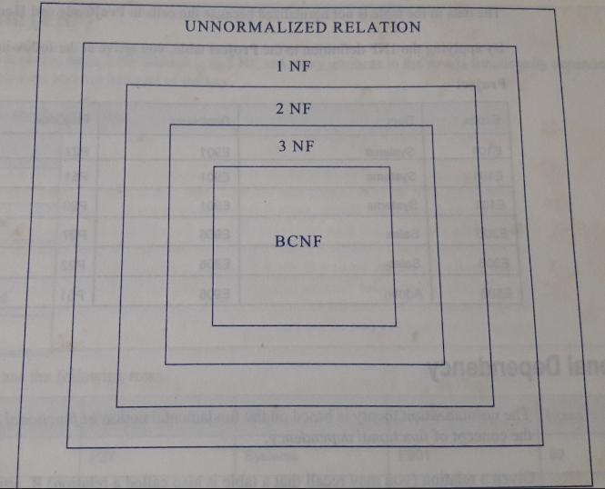

Slide 85
Summary
In this module we learnt
What is normalization
Goals Of Normalization
Problems with un-normalized data
Normal forms

Slide 86
References
Department of Computer Engineering (1967). Entity- Relationship Model. Retrieved on January 3, 2011, from, www.ceng.metu.edu.tr
Alien Coders (2010). Basics of Normalization with examples by Prashanth Retrieved on April 14, 2012, from, http://www.aliencoders.com/content/basics-normalization-examples

